Slide 1
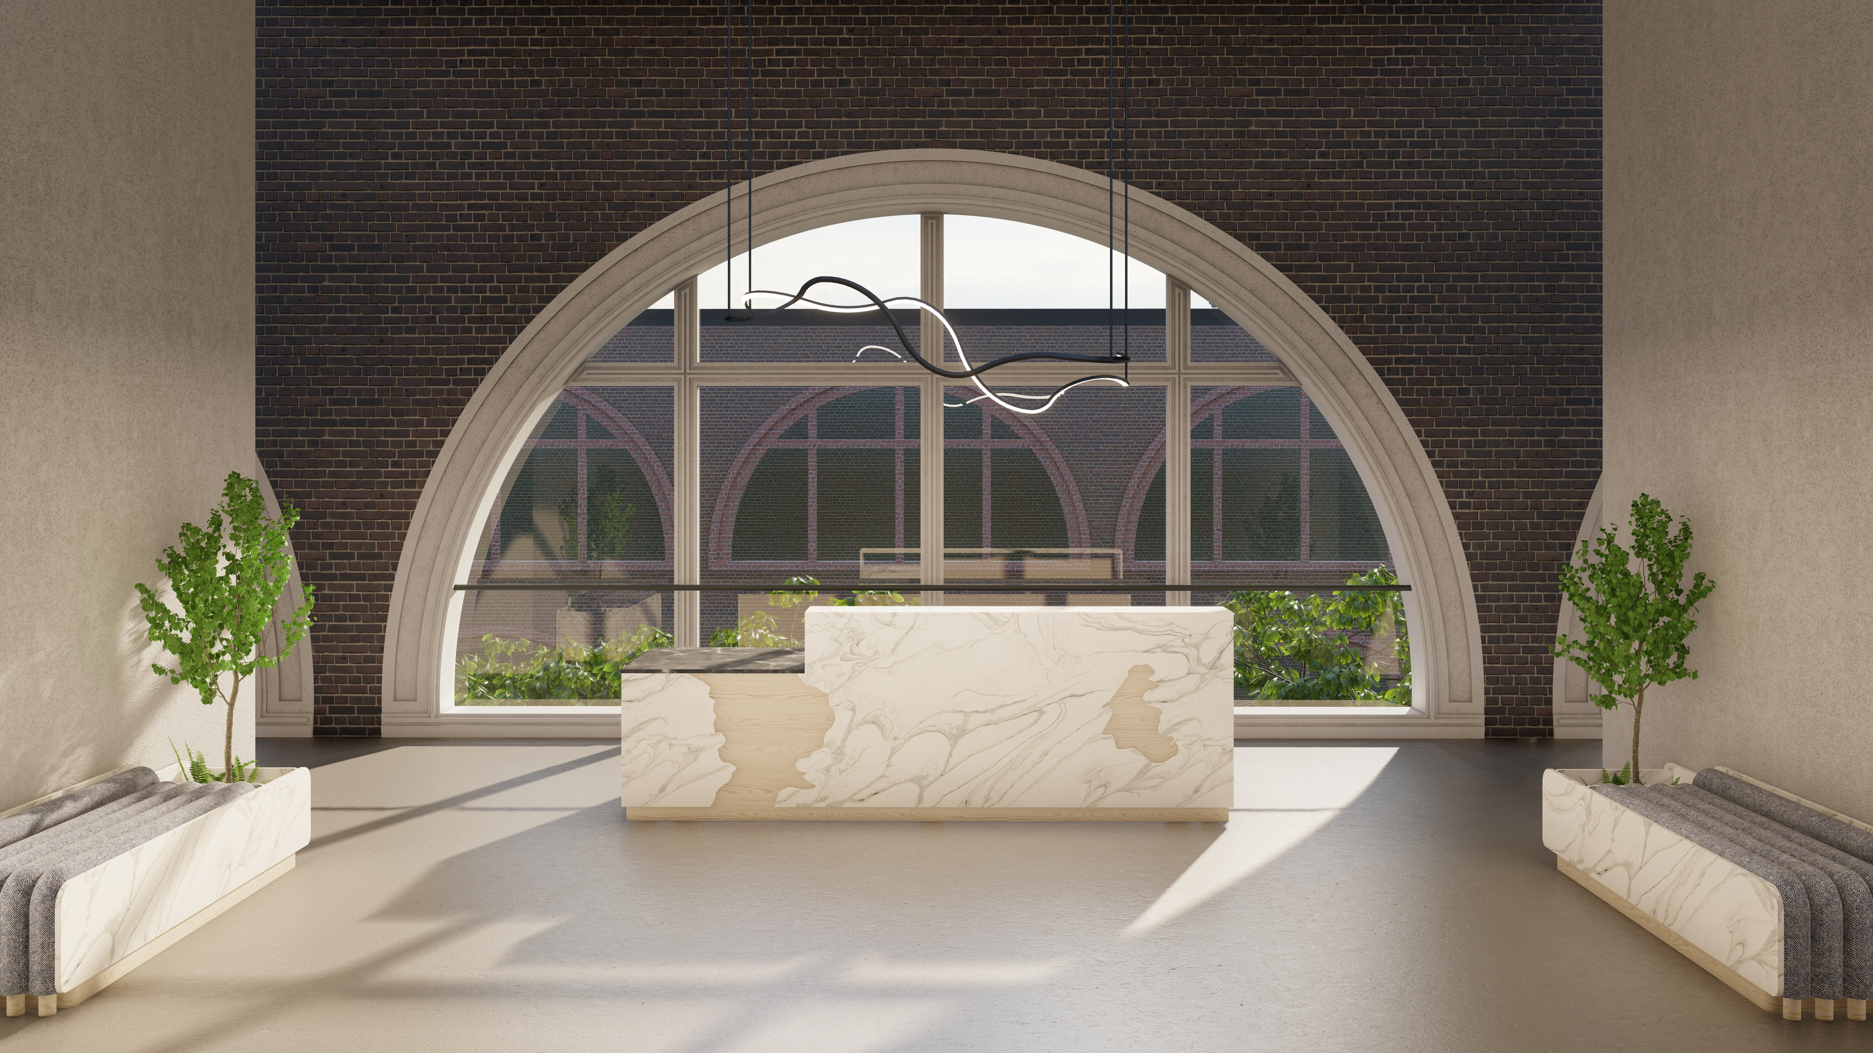
msa industries

Slide 2
Hybrid
hy·brid \ ˈhī-brəd \
… we can’t think of a better word to describe us.

Slide 3
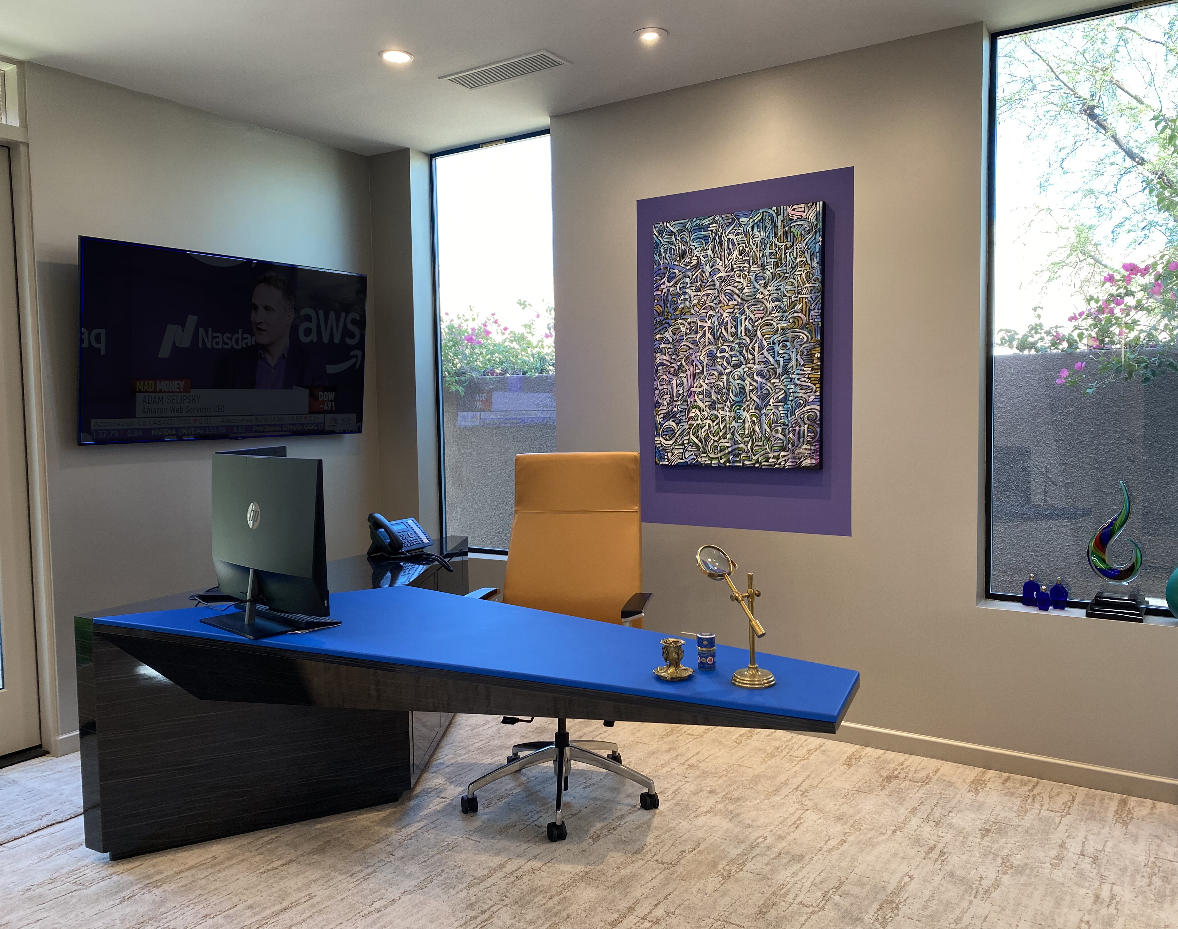
Custom Fabrication
Laminate, Metal Framework, Leather Surface

Slide 4
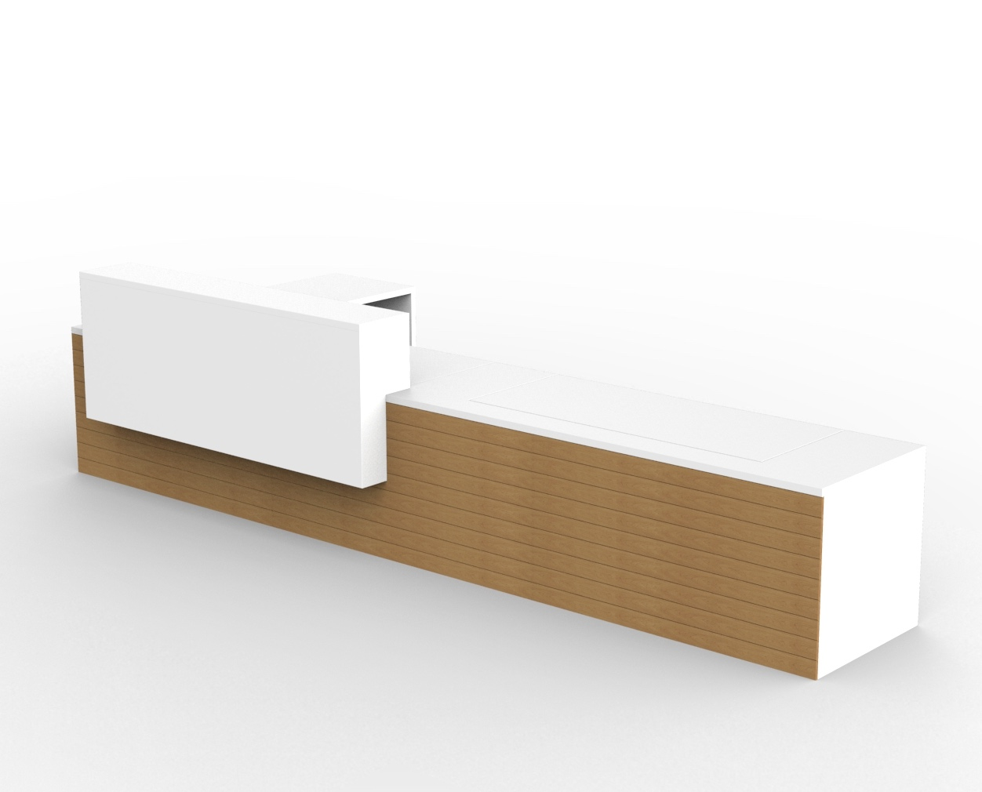
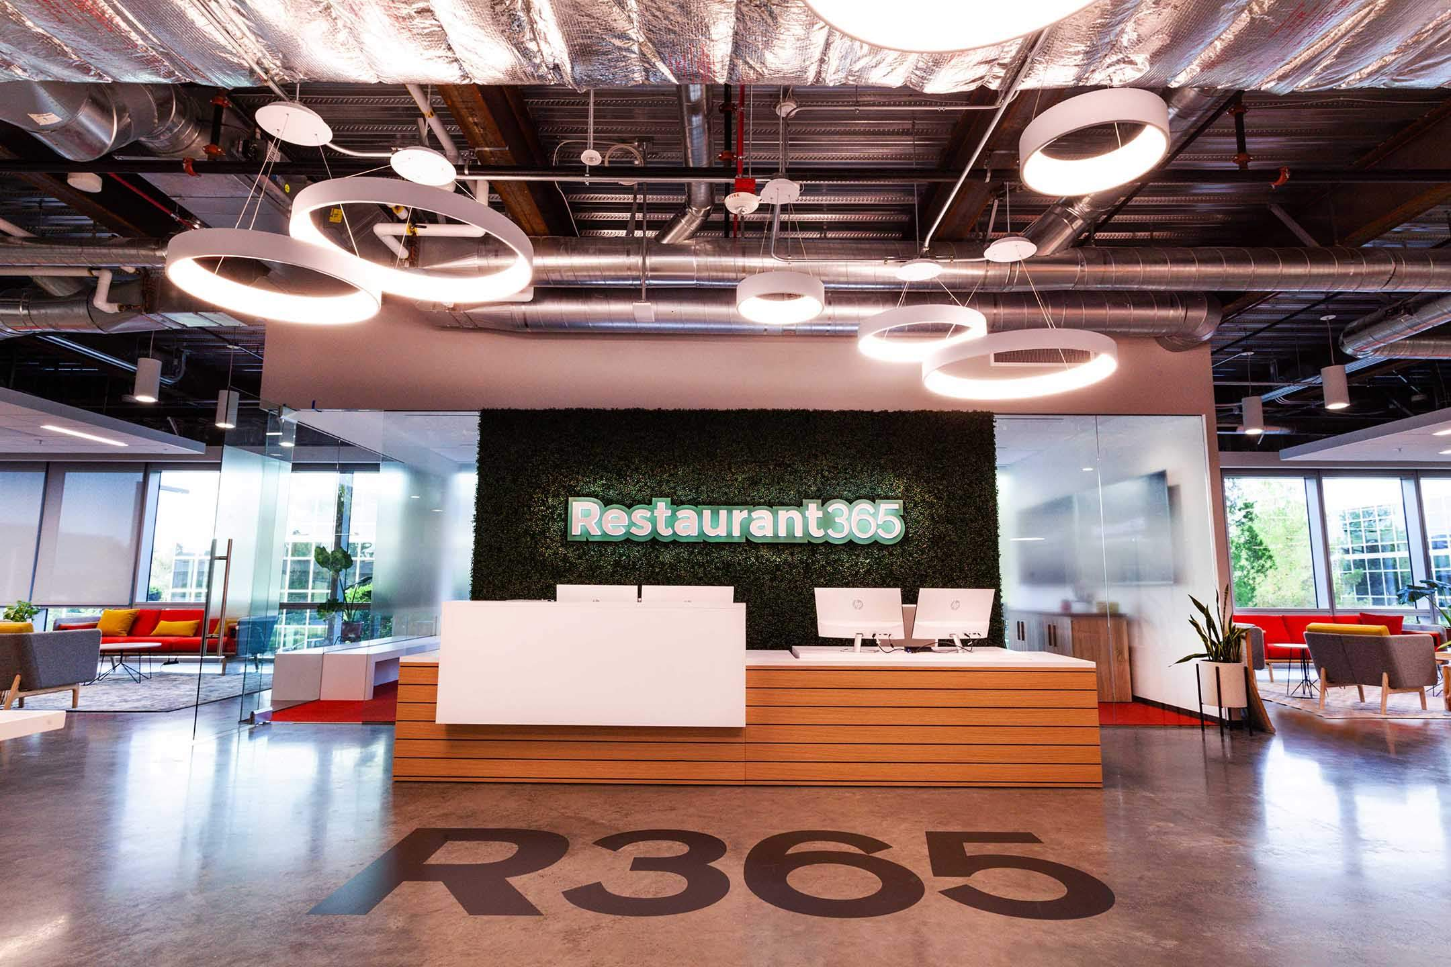
Custom Fabrication
Veneer & Laminate Reception

Slide 5
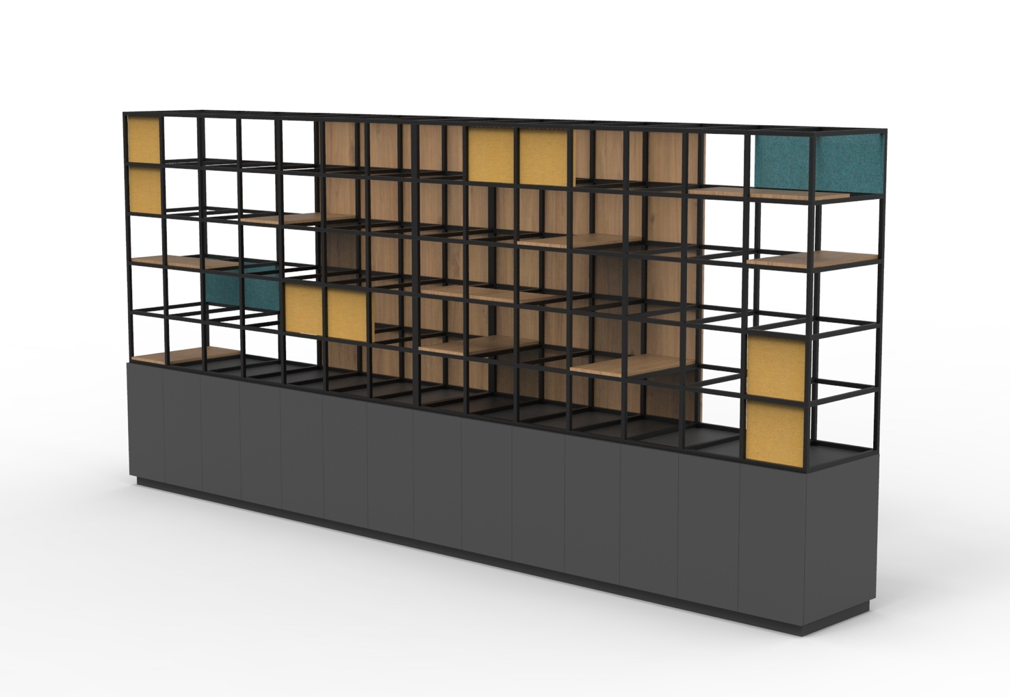
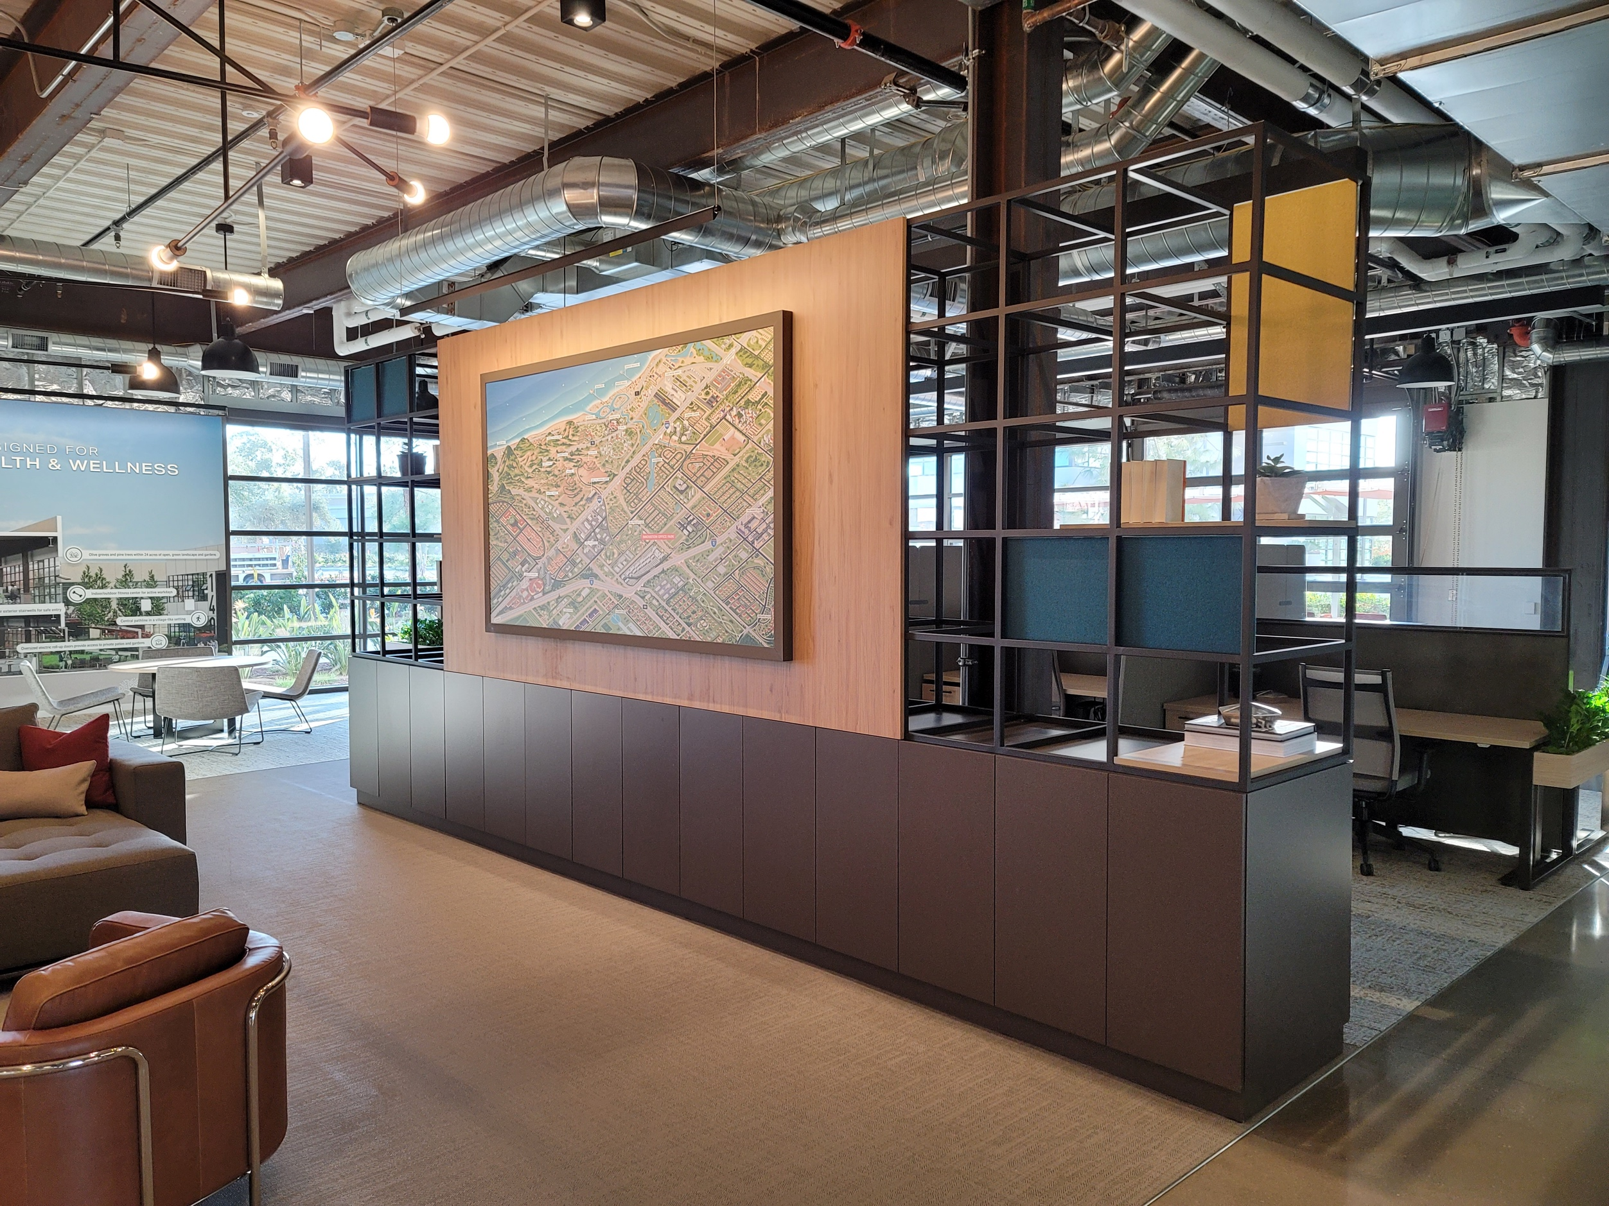
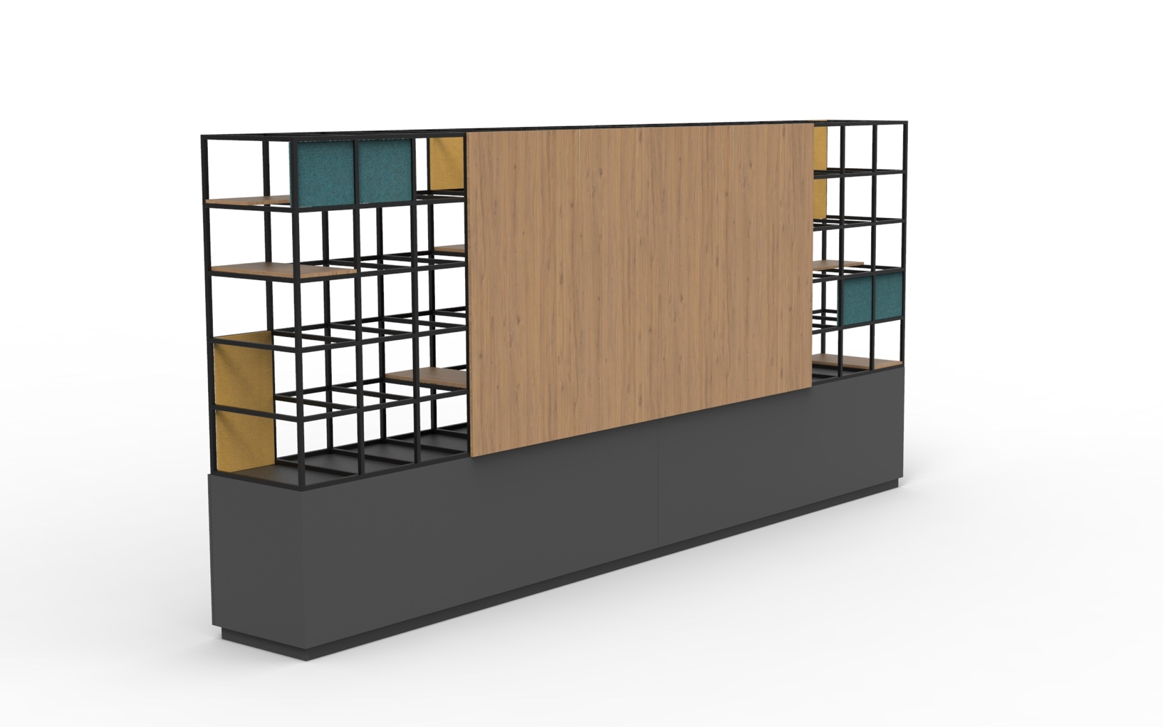
Custom Fabrication
Laminate, Metal Frames, Felt Accents

Slide 6
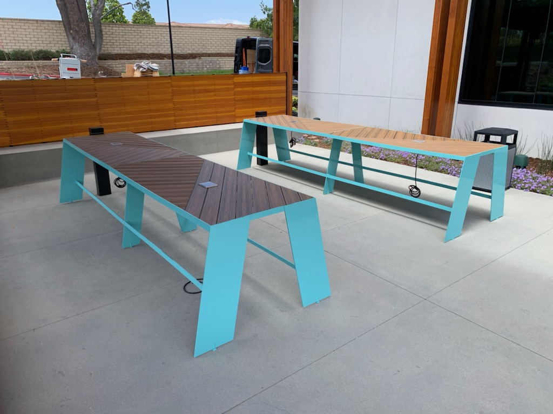
Custom Fabrication
Outdoor Steel & Faux Wood (TREX)

Slide 7
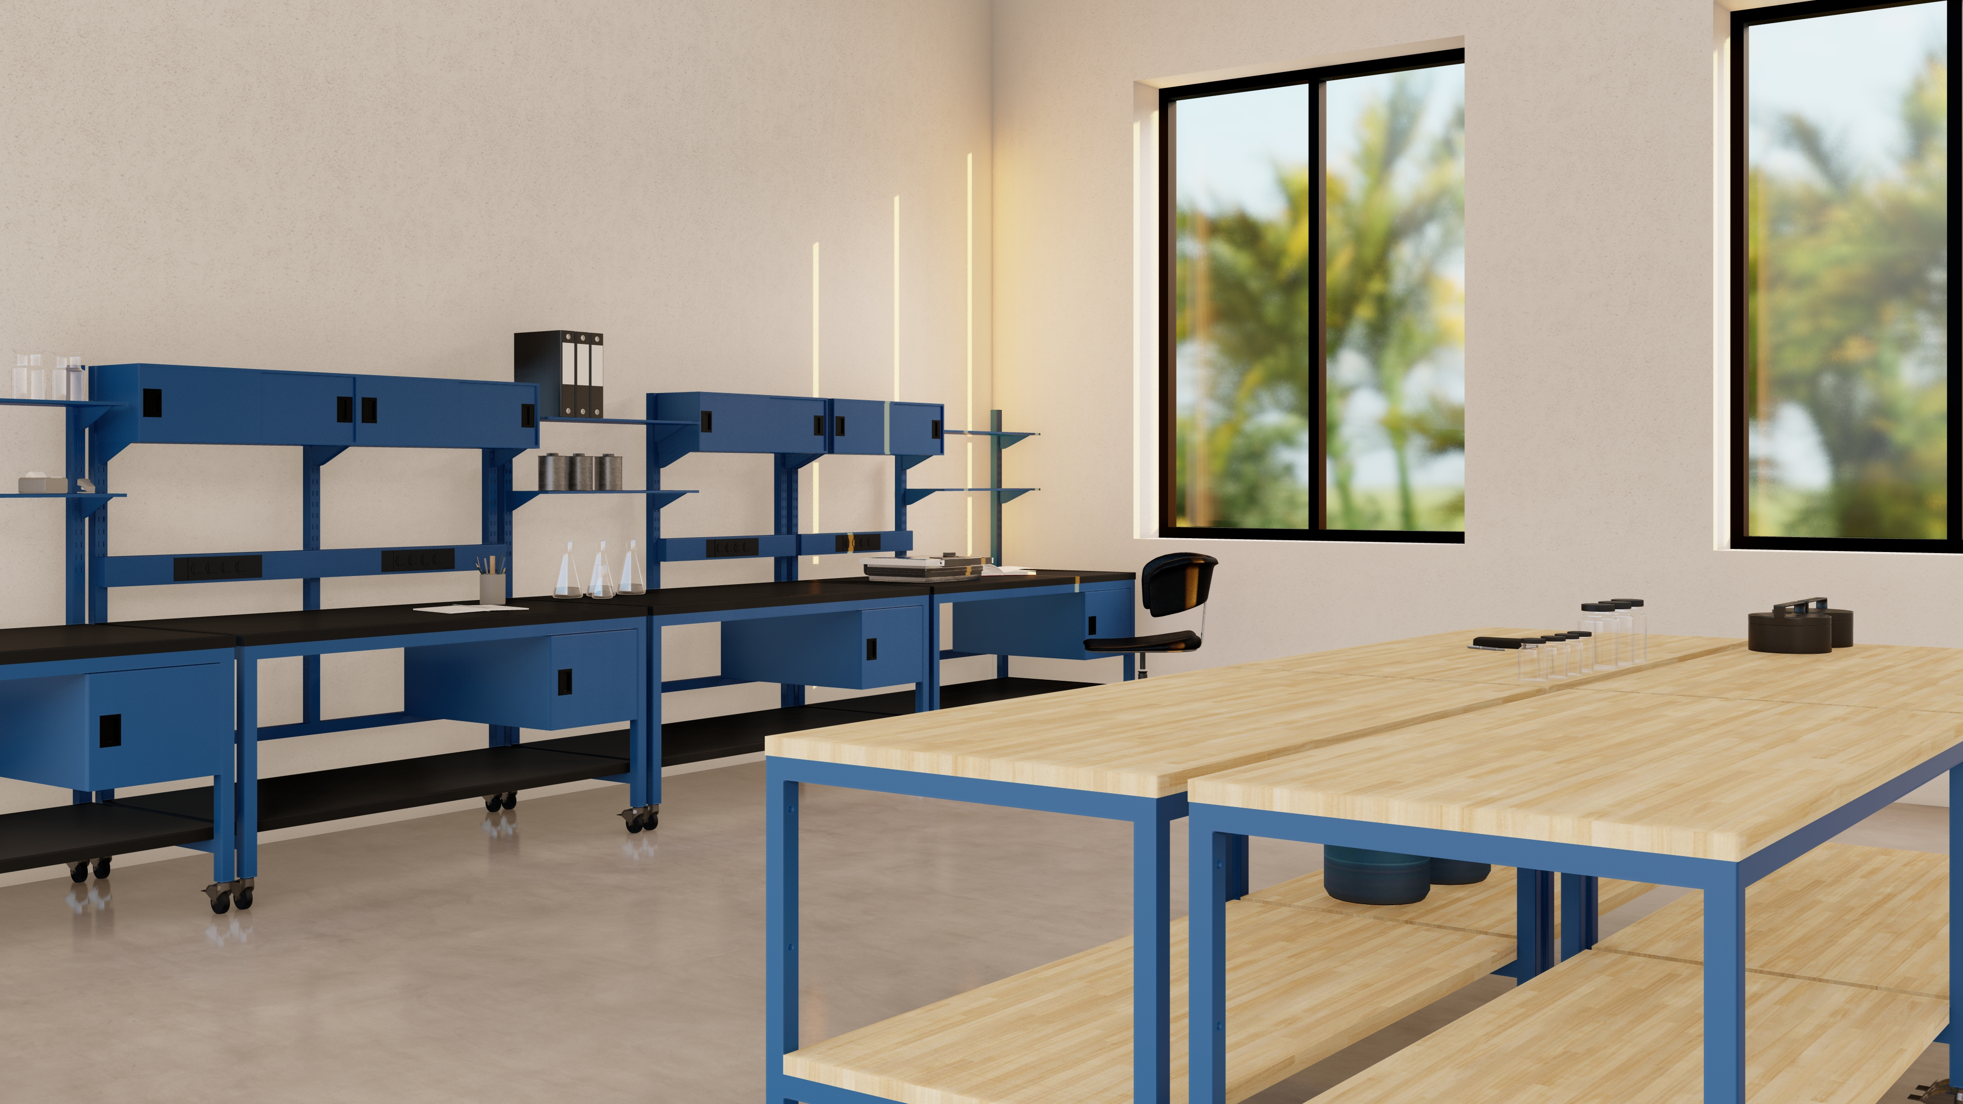
Custom Fabrication
Laboratory & Industrial

Slide 8
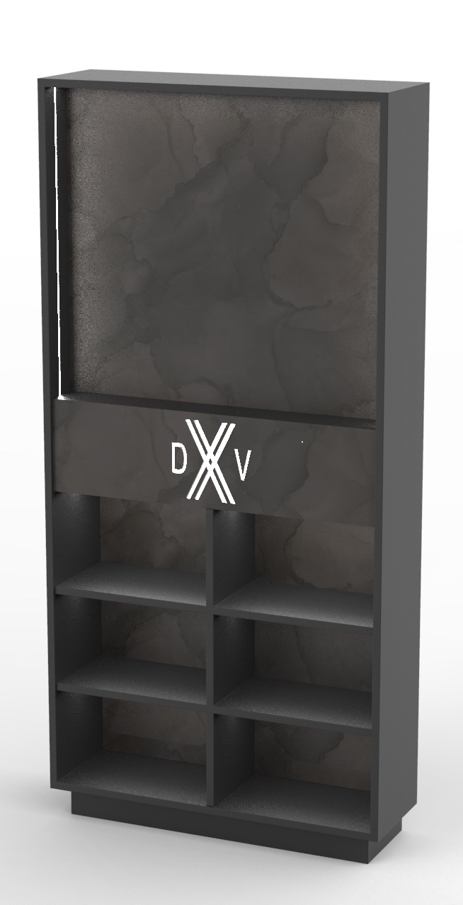
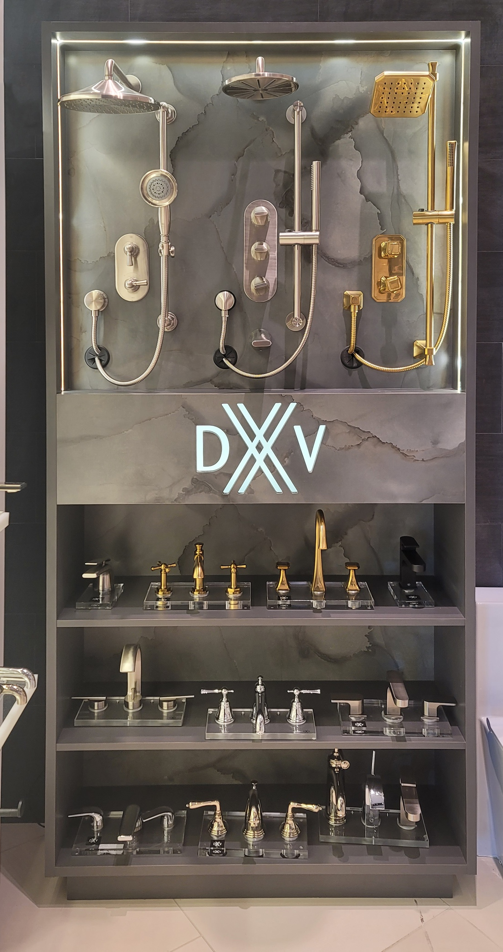
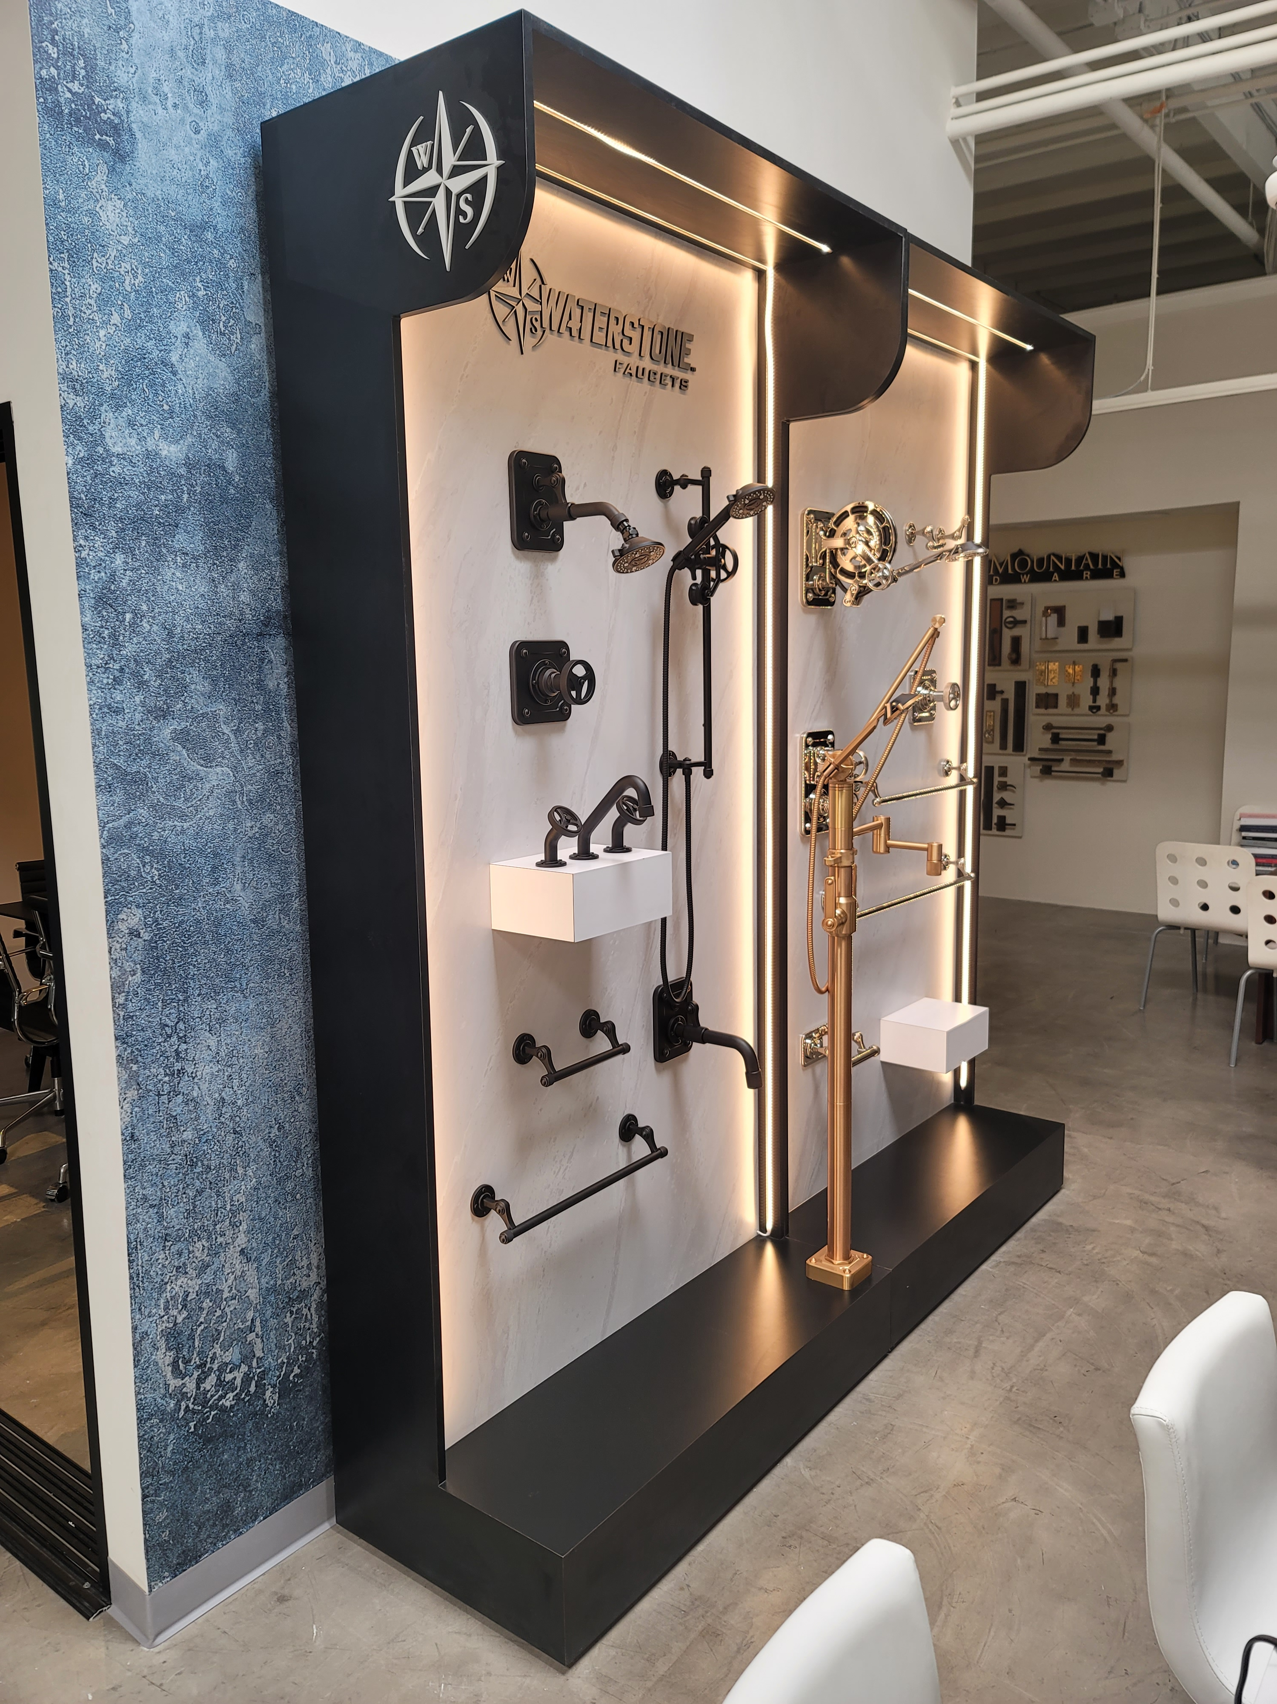
Custom Fabrication

Slide 9
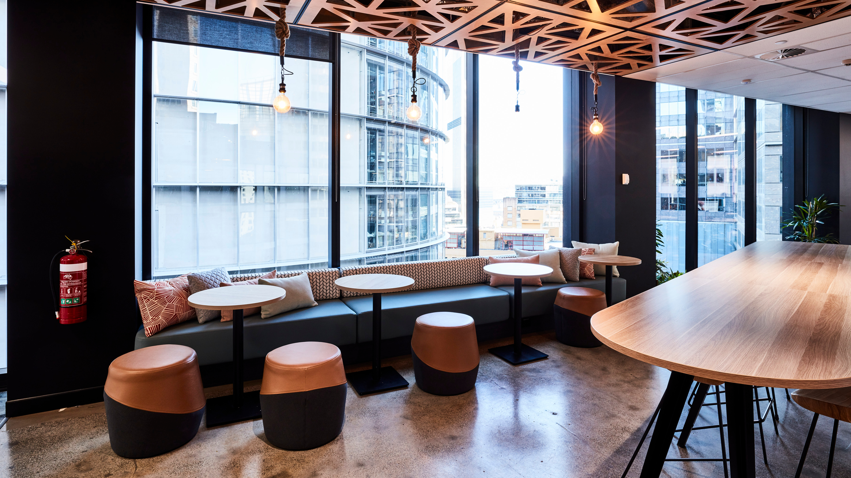
Marbella Designs

Slide 10
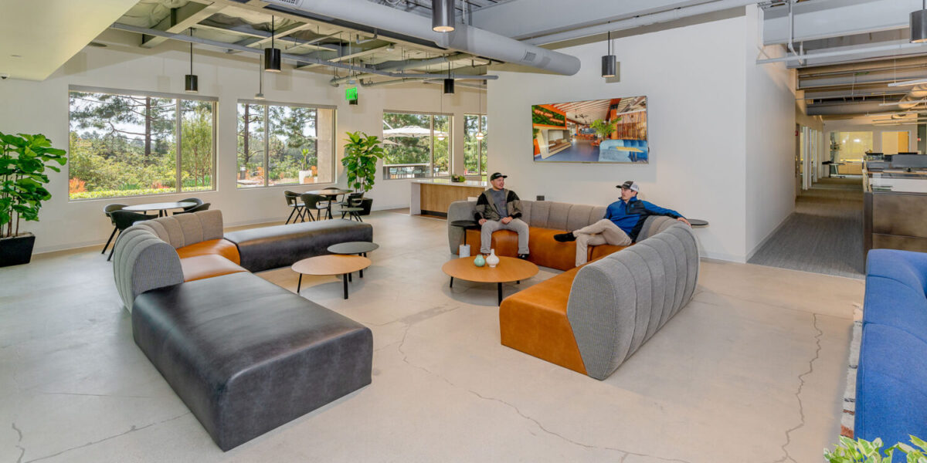

Slide 11
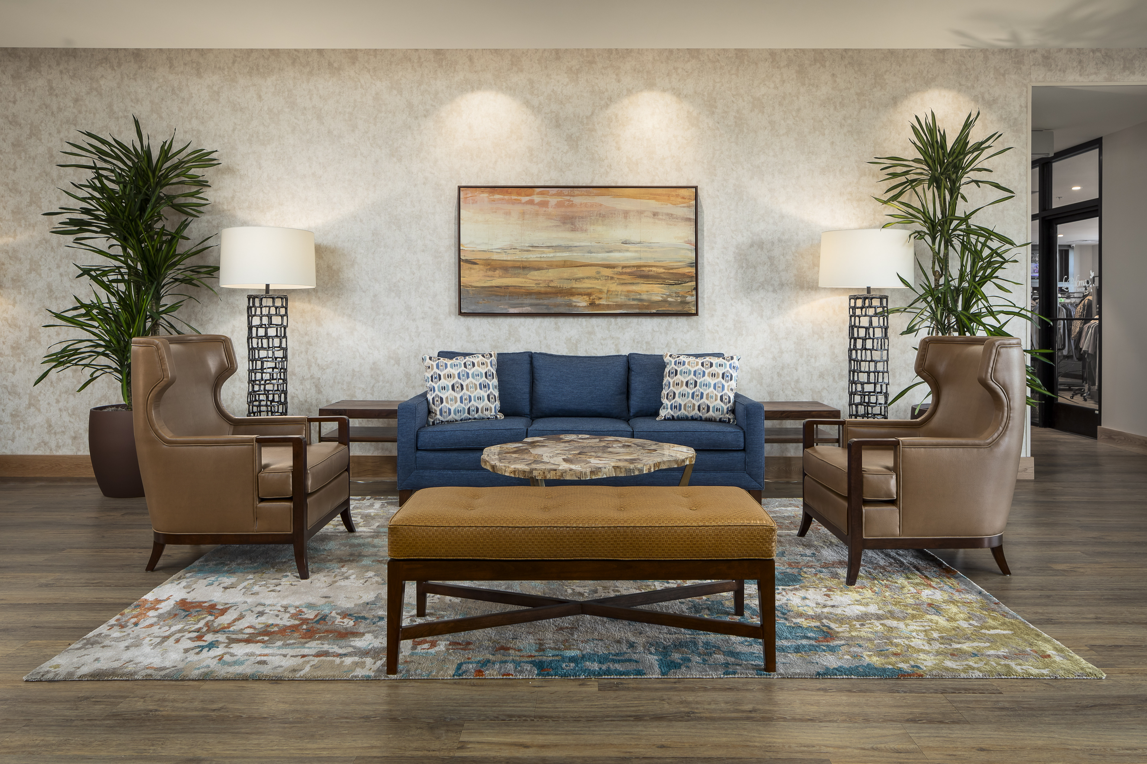

Slide 12
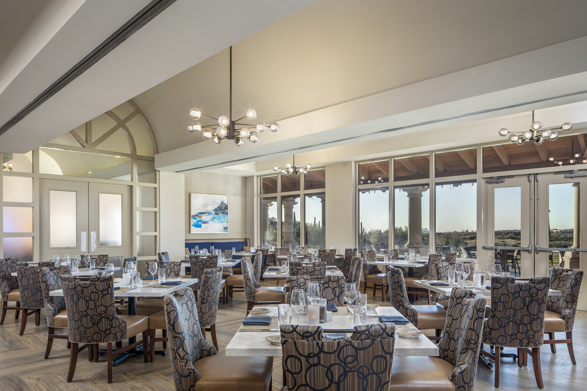

Slide 13
